Slide 1

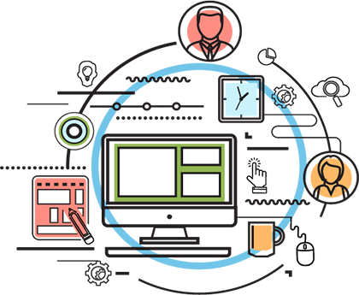
SAPERP: Introduction
Level–Practitioner

Slide 2
About the Author
Created by | Yarra, KamaRaju (Principal Consultant - ERP, AVM-EAS-SAP-Tech - Int (PI/PO))
Credential Information | SAP PI Overview & Architecture
Version and Date | Version 1.0

Slide 3
ERP
Introduction to SAP ERP
What are Enterprise Resource Planning (ERP) Systems?
Incredibly large, extensive software packages used to manage a firm’s business processes.
Standard software packages that must be configured to meet the needs of a company
Database programs with the following functions:
Input
Storage/Retrieval
Manipulation
Output
28,610+ Tables in SAP

Slide 4
ERP
Who are the big ERP vendors?
SAP, the German juggernaut
Systems, Analysis and Products in Data Processing.
Don’t be a sap!
Oracle/PeopleSoft/J. D. Edwards (J.D. Orisoft)
Microsoft Great Plains, aimed at smaller companies
SAP Business One is competing product

Slide 5
SAP R/3 Enterprise
FI
Financial
Accounting
QM
Quality
Mgmt.
PS
Project
System
PM
Plant
Maint.
PP
Prod.
Planning
SD
Sales &
Distrib.
MM
Materials
Mgmt.
Workflow
HR
Human
Resources
AM
Asset
Mgmt.
CO
Controlling

Slide 6
Clients in SAP R/3
What is a client?
A way to separate data in the system
In some ways, a separate database
Also, a table entry
Column (attribute)
Field
Mandt
Client
201
Row
(Record)
201
201
202
202

Slide 7
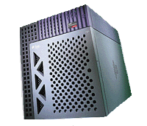
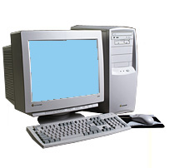

Logging On – SAP GUI
To log on to an R/3 system with the SAP Gui, you need the proprietary SAP Gui (Graphical User Interface) software loaded on your system and an internet connection
Internet Connection
Account on
SAP R/3 System at hosting site
PC with SAP Gui

Slide 8
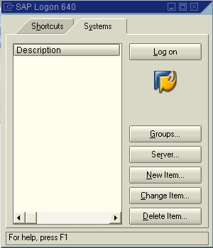
SAP GUI Configuration
First, you need to tell the SAP Gui which system you want to log into:
If you don’t have
any systems defined,
click on New Item

Slide 9
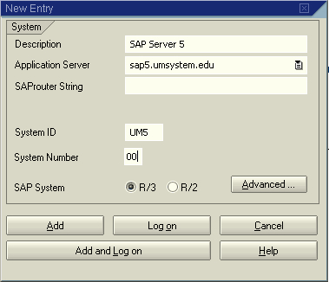
System Definition (provided by UCC)
Text description (free)
Address of system (e.g.
sapd.umsystem.edu)
SAP Router usually
not required
System ID
Logical name of system
System Number
Frequently 00, but not always
R/3 System Selected

Slide 10
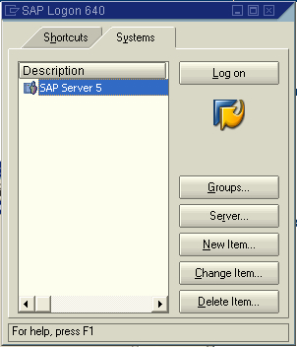
Configured SAP Gui
Select System:
double-click or
Logon button

Slide 11
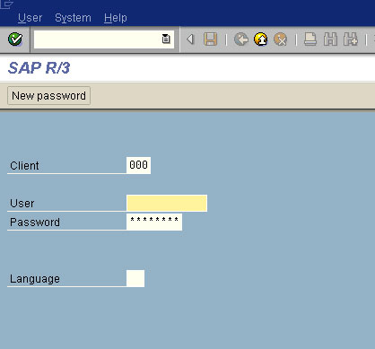
Logging On
Enter Client
Enter User (R/3 Account)
Enter Password (R/3 Account)
Don’t worry about language—
English will default in

Slide 12
SAP User-IDs and Passwords
SAPGUI - System ID | PIT
SAPGUI - Description | PIT – PI training system
SAPGUI - Application Server | CTSINTBMVSTR3
SAPGUI - System Number | 00
Client Number | 001
SAPGUI Router String | /H/10.226.33.12/H/10.237.205.16/H/
Direct Access from Run Command | sapgui.exe /H/10.226.33.12/H/10.237.205.16/H/10.242.196.51/S/3200
Java Access URL | http://ctsintbmvstr3.cts.com:50000

Slide 13
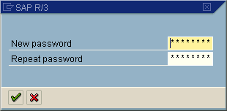
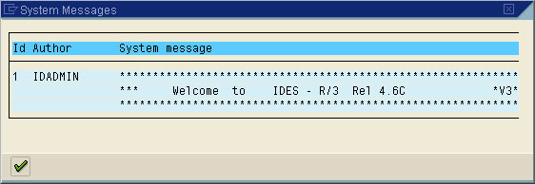
Logging On ...2
On the first time logging in to
a new account, you will have
to change the password—try
To remember your new
Password WITHOUT WRITING
IT DOWN!
Then a message or two
Then . . . .

Slide 14
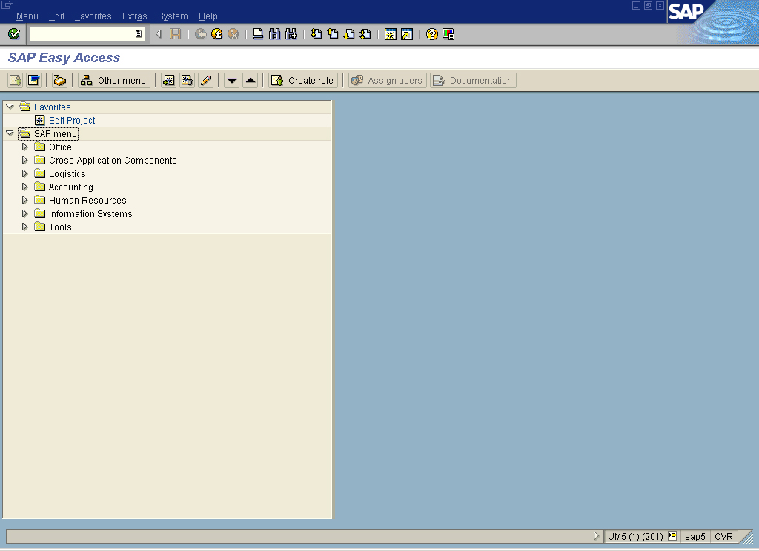
Success !!
SAP Easy Access
Master Data Entry
Transaction Data Entry

Slide 15
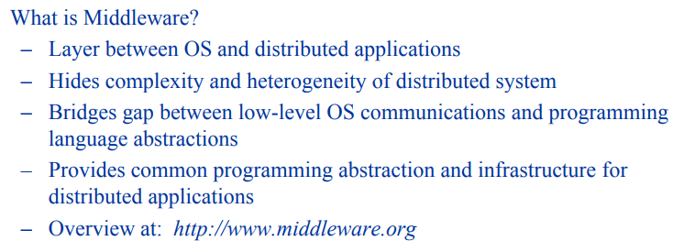
Introduction to Middleware

Slide 16
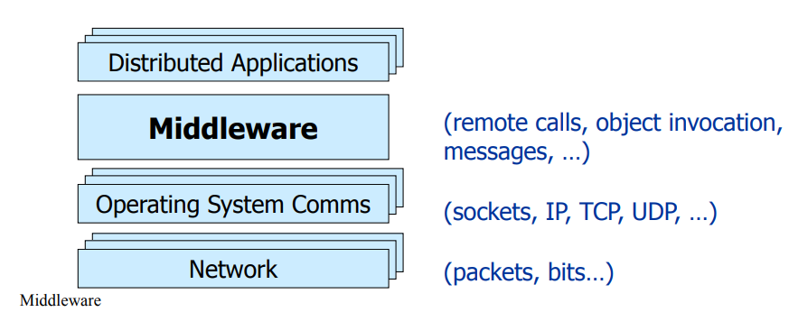
Introduction to Middleware

Slide 17
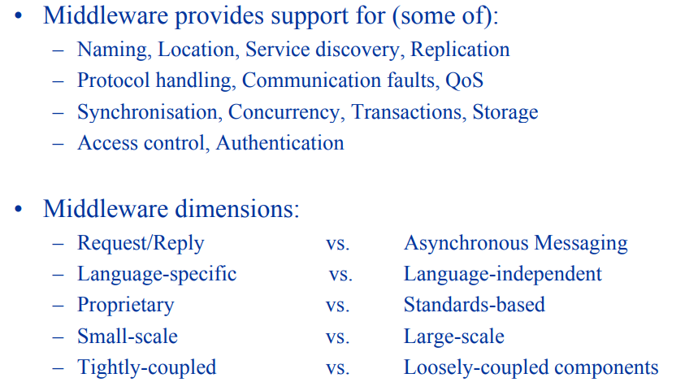
Introduction to Middleware

Slide 18
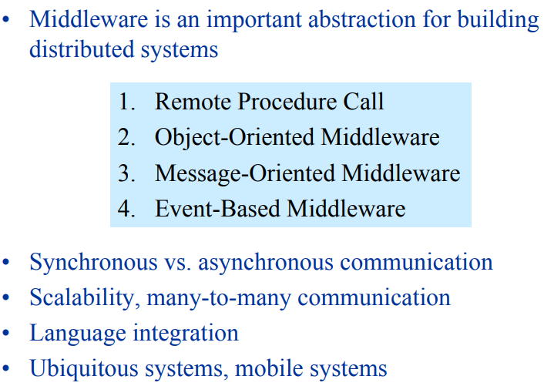
Introduction to Middleware

Slide 19
You have successfully completed
SAP and Middleware Overview.

